Slide 1

E-commerce Sales & Customer Behavior Dashboard

Slide 2

Outline:
Project Objective
Key Metrics (KPIs)
Top-Selling Products
Monthly Sales Trend
Customer Segments
Sales by Region
Return Insights
Customer Behavior
Key Takeaways

Slide 3
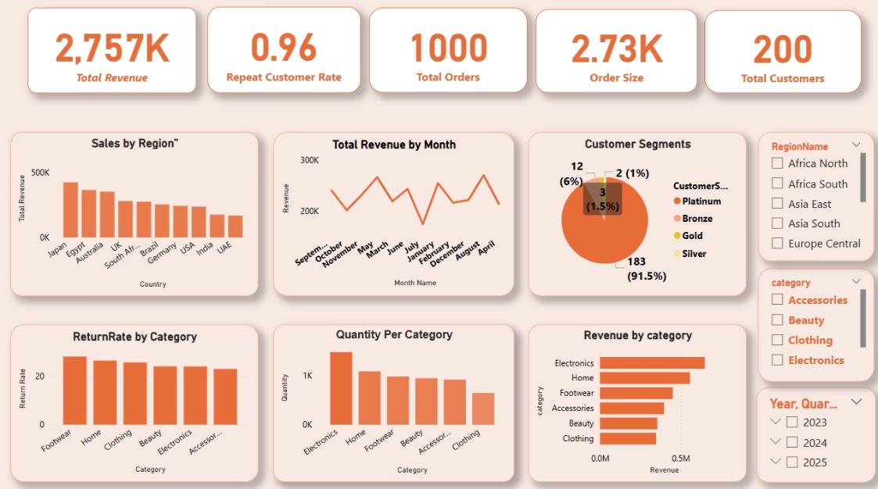
Objective:
Understand customer behavior, sales trends, and product performance

Slide 4
Key Business Performance Metrics
Metric
Value
What It Tells Us
Total Revenue
2,757K
Reflects strong product-market performance.
Repeat Customer Rate
96%
Indicates high loyalty and satisfaction.
Total Orders
1,000
Total orders
Average Order Size
2.73K
Shows customer purchase value.
Total Customers
200
Number of unique customers.

Slide 5
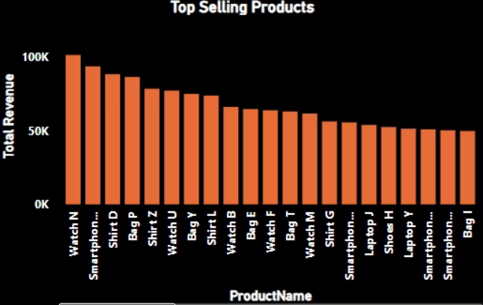
Best-Selling Products
Insights:
Watches and smartphones are top earners
Focus on these products for future promotions

Slide 6
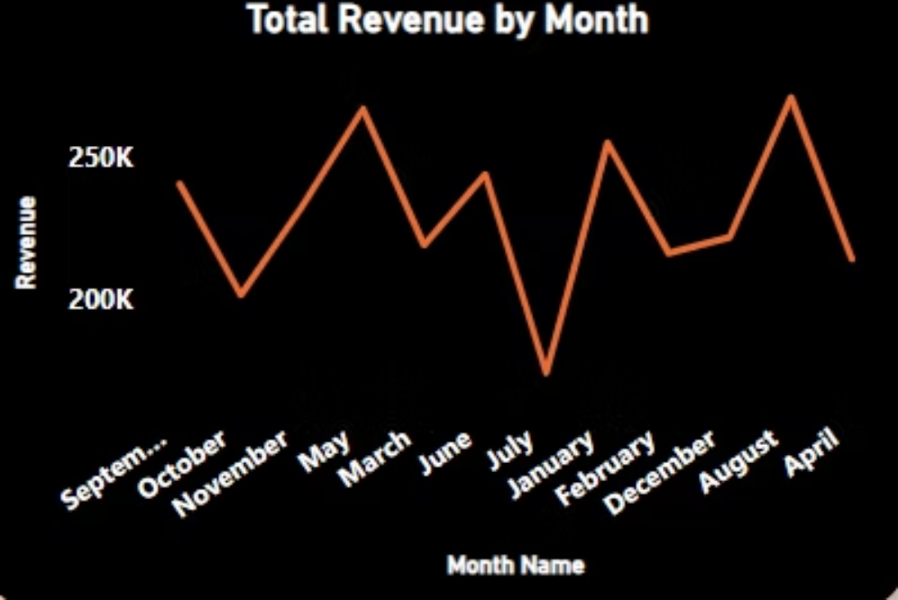
Revenue Over Time
Insights:
Spikes in sales during a few months
Reason: Likely special offers or festival sales
Helps plan campaigns better in those months

Slide 7
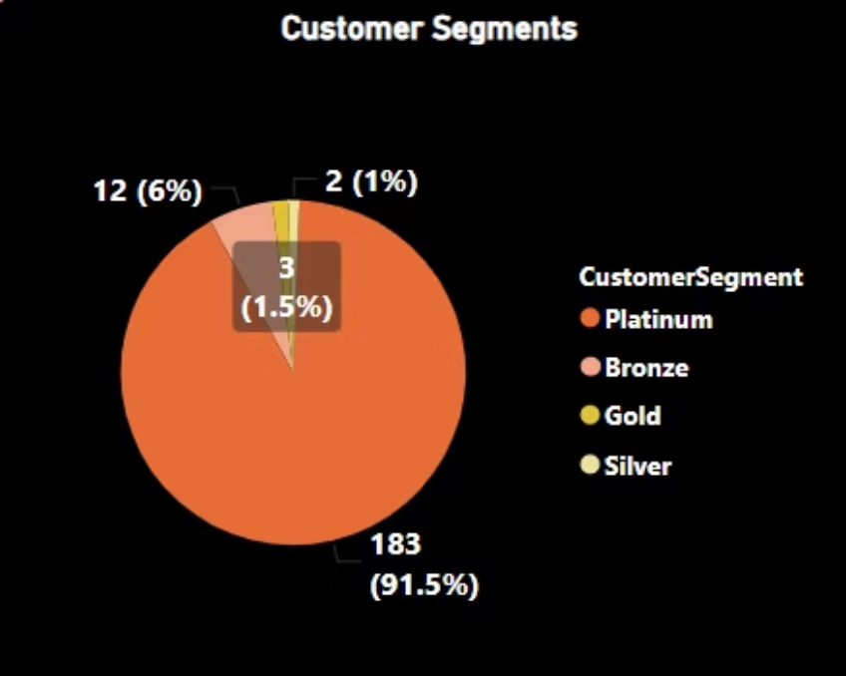
Customer Categories
Insights:
Most customers are in Platinum → They buy often
Consider loyalty rewards to retain them.

Slide 8
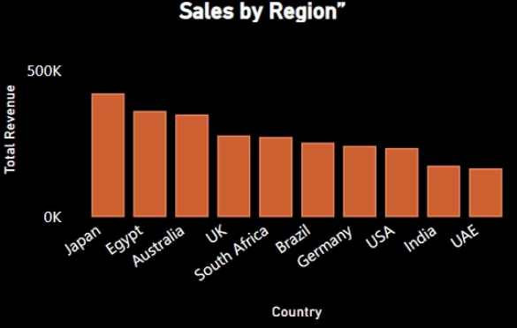
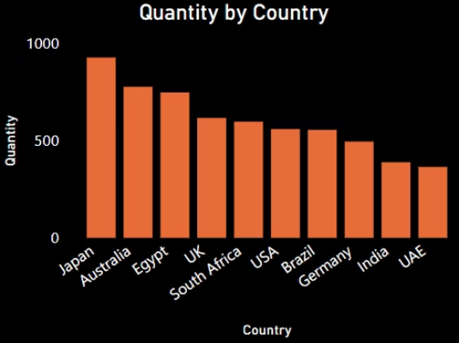
Sales & Quantity by Country
Japan, Egypt, and Australia are the top-performing countries in both total revenue and quantity sold.
UAE and India consistently rank at the bottom, indicating lower customer engagement or market penetration.
The alignment between high quantity and revenue in Japan and Australia suggests both strong order volume and high-value purchases.

Slide 9
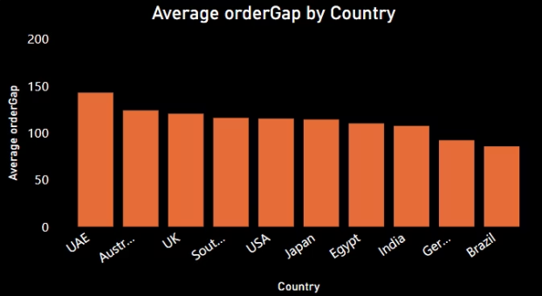
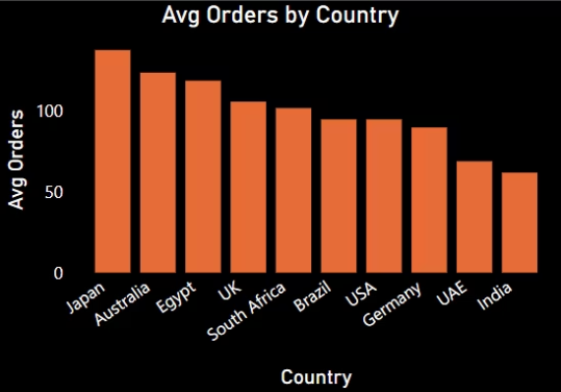
Average Order Gap & Orders by Country
UAE has the longest gap between orders, meaning customers take longer to buy again.
Brazil and Germany have shorter gaps, showing customers order more often.
Japan and Australia have the most orders overall, showing they are very active regions.
India and UAE have fewer total orders and less frequent buying.

Slide 10
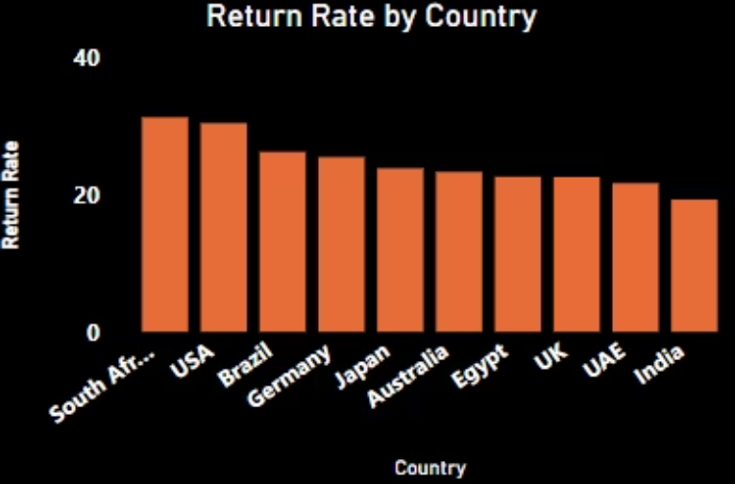
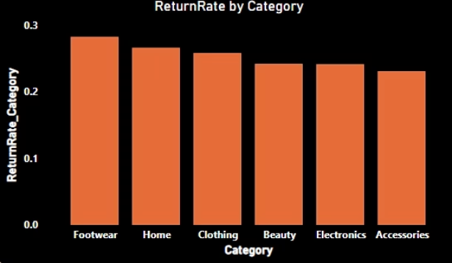
Return Rate by Category
Focus on improving product descriptions and sizing guidance for high-return items.
Investigate return reasons in South Africa, USA, and top-return categories.
Use low-return countries and categories as benchmarks for quality and customer satisfaction.

Slide 11
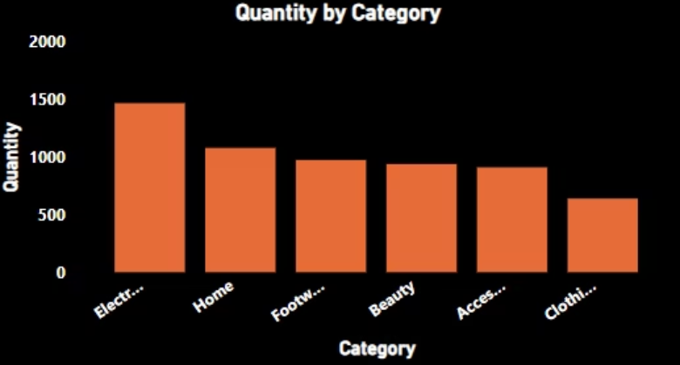
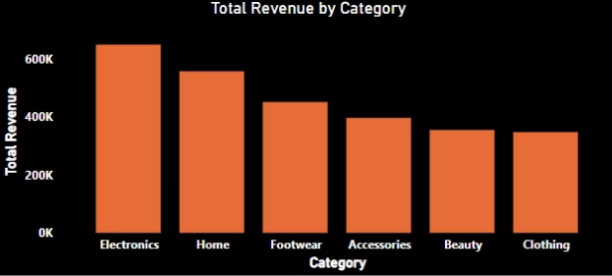
Electronics is a high-performing category in both quantity and revenue — it drives the most sales volume and value.
Clothing shows the lowest performance across both metrics — worth reviewing for product positioning, pricing, or promotions.
Focus on boosting revenue in lower-performing but mid-volume categories like Accessories and Beauty by exploring upselling or bundling strategies.

Slide 12





Insights
Most customers buy again → Offer loyalty rewal
Sales are higher in certain months → Run ads or discounts during those times
Too many returns in Home & Footwear → Check quality or improve product info
Some regions buy more than others → Focus marketing on those areas

